Slide 1



Effect of Terrestrial Microplastic particles on soil properties
Rachel Hamilton
Dr. Jeffrey Fehmi
University of Arizona School of Natural Resources and the Environment
Arizona Space Grant
Statewide Symposium
April 14, 2018

Slide 2
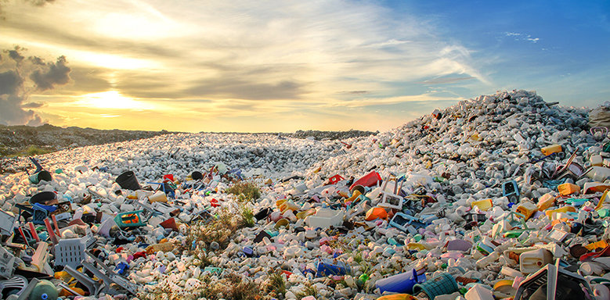
Plastic Pollution in a Global Context
Estimated 9 billion tons of plastic waste produced throughout history
280 million more tons of new plastic generated every year
Plastic now comprises approx. 10% of waste but a larger percentage of debris- expected to keep increasing
Rivers transport millions of tons of plastic to the ocean annually
Image source: Mohamed Abdularaheem / Shutterstock

Slide 3
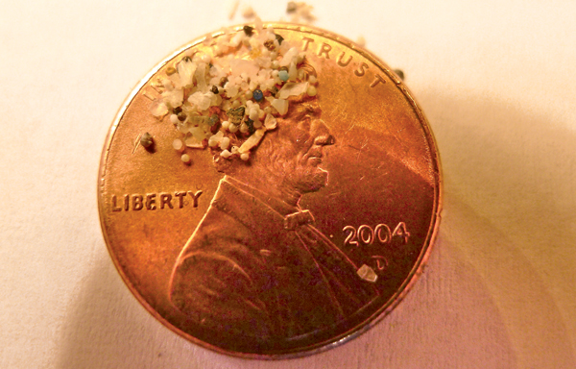
Microplastic
Result of plastic photodegredation on a large scale
Loosely defined as plastic pieces between 1μm and 5mm in longest dimension
Comprise 70+% of plastic debris in some areas
Aid in the transport of POPs (persistent organic pollutants)
Easily ingested by animals
Worth studying due to inevitable ubiquity in all environments, difficulty of removal, and high risk of impacts
Image source: 5Gyres Institute

Slide 4
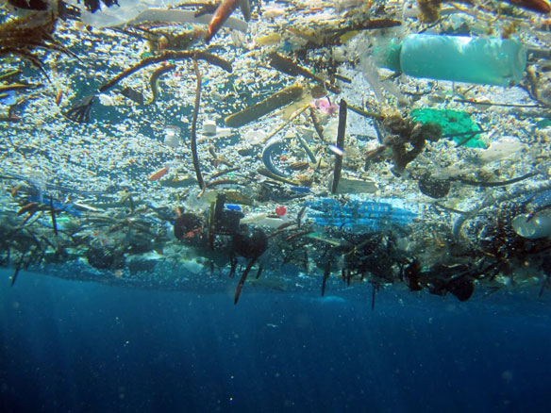
Marine impacts of Plastic
Since 2000, research concerning marine plastic pollution has exploded
“Great Pacific Garbage Patch”
Negative impacts demonstrated throughout the marine ecosystem
More than 180 species with documented ingestion of plastic
Microplastic pellets found in all levels of plankton food chains
Image source: NOAA

Slide 5
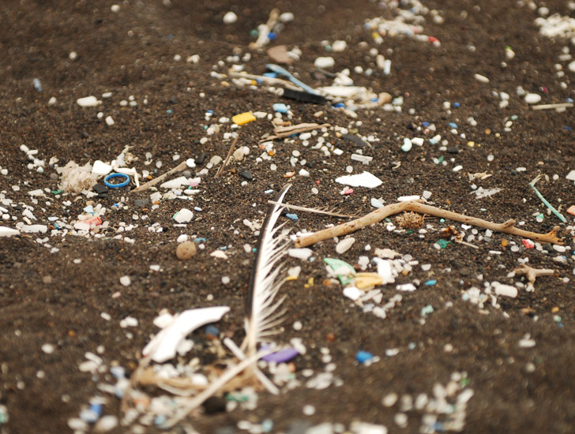
Plastic in desert environments: where does it go?
Not all plastic waste makes it to bodies of water
Plastic debris photodegrades and integrates into the soil
Malaysian scientists searched for plastic pieces in a remote mangrove forest and found plastics 5cm deep
Since plastic is everywhere, what does this mean for the environment?
Image source: 5Gyres.org

Slide 6
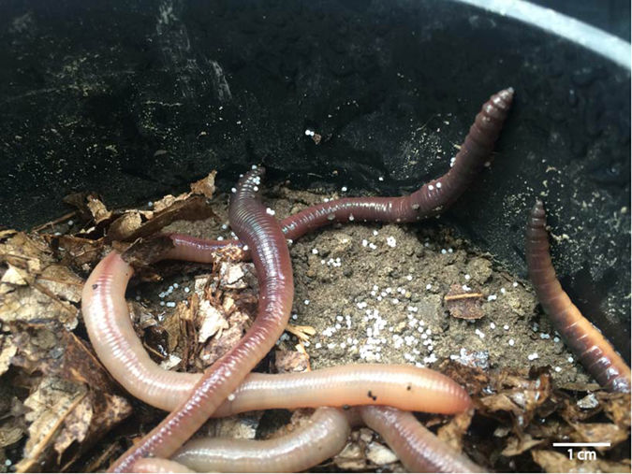
KNOWLEDGE GAP
Almost no terrestrial studies have been done to mirror marine findings
Modest correlations found between microplastic ingestion and reduced activity and longevity in earthworms
Evidence that pieces ingested by earthworms can spread deep into soil
How does this affect plants and the terrestrial food chain?
Image source: Rillig, Ziersch, and Hempel (2017)

Slide 7
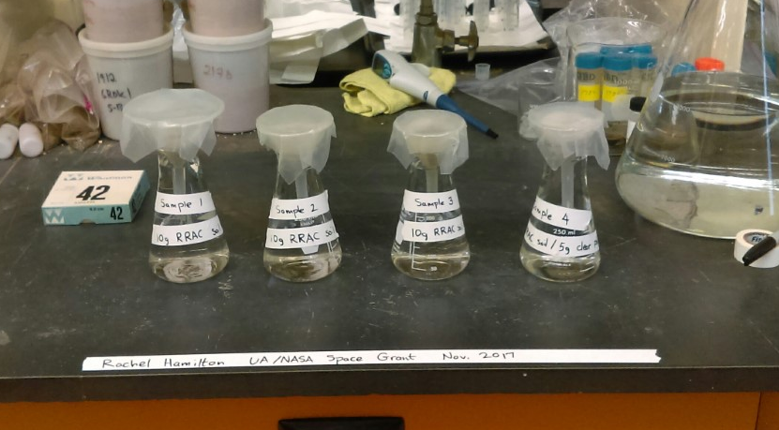
Soil properties: Water Holding Capacity
Soil water holding capacity: how much water the soil can retain—important to agriculture
Experimented on the presence of polyethylene (PE) powder and pellets on soil water holding capacity
Found that soil and plastic mix had water holding capacity reduced by 15% (plastic pellets) and 85% (plastic powder)

Slide 8
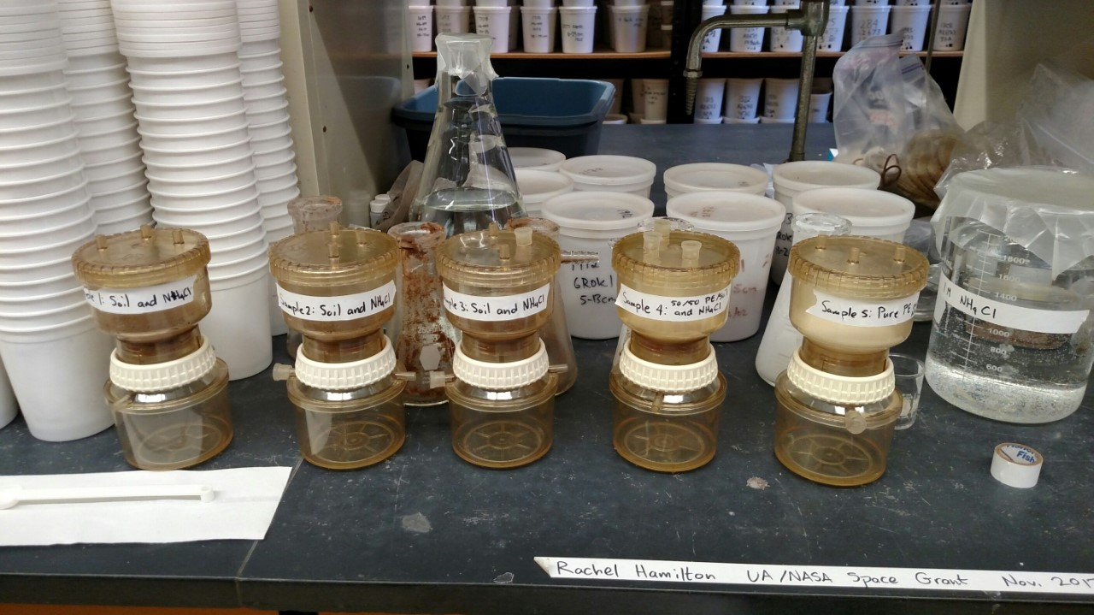
Soil properties: Cation Exchange Capacity
Cation exchange capacity: ability of soil to hold positive cations
Measure of nutrient availability and resistance to acidification of soil
High cation exchange capacity implies fertile soil

Slide 9
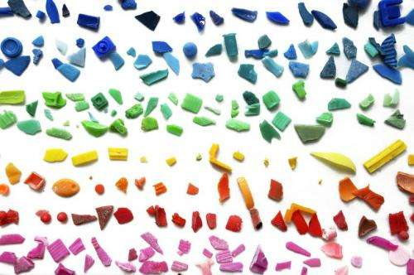
What next?
Investigation into effects on other soil properties
Characterization of plastic in the environment and identification techniques for microplastic: separation and spectroscopy methods
Further exploration of plastic in terrestrial systems: animals, plants
Potential impacts on human health and agriculture- and how to mitigate them
This is just the beginning!
Image source: Spanish National Research Council

Slide 10
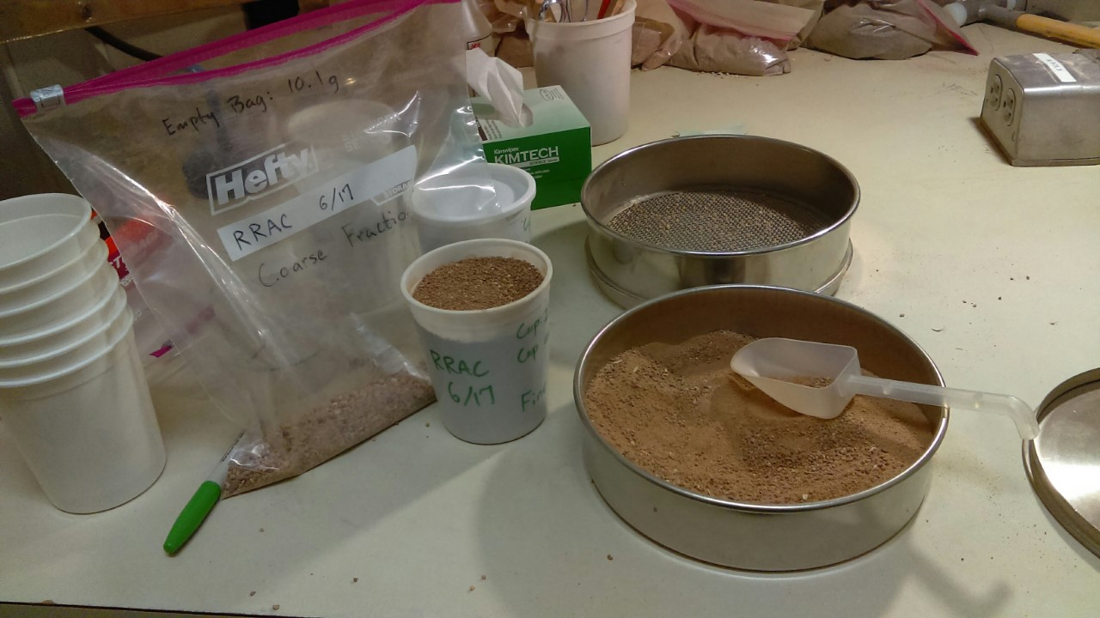
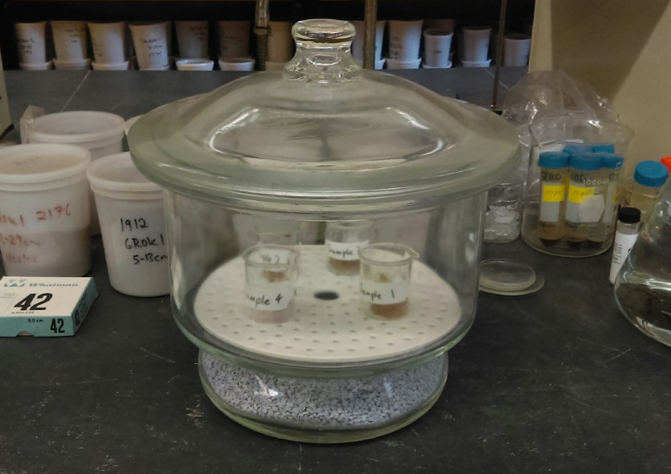
Acknowledgements
A personal thank you to
Dr. Craig Rasmussen
Chris Shepard

Slide 11
THANK YOU

